Slide 2
The Top 10 things you need to know about Docker on Azure
AZR325
Tom Hauburger, Khalid Mouss
Azure Linux Team

Slide 3
Confidentiality Slide

Slide 4
Notes (hidden)
Some speakers at Microsoft like to use this slide for hidden “notes slides”.
Delete it if you don’t want to use it.
NEXT: <next slide title>

Slide 5
Speakers, Please Read (hidden slide)
Please consult your Track PM (listed below) for track details and a list of attendees that have added your session to their personal schedule builder calendar.
Track Name, Acronym and Track PM
Architecture (ARC) – Sara Mocke, Terra Suddarth
Business Analytics (BA) – Sanjay Soni, Maxine Coo
Business Solutions (MSDY) – Julie Zunker, Lindsey Ralston, Mollie Brodt, Angela Ralston
Cloud and Datacenter Platform (CDP) – Brannan Matherson, Julie DesCamp
Data Platform (DP) – Karthika Raman, Maxine Coo
Development Tools & Technologies (DEV) – Beth Massi
Enterprise Mobility (EM) – Thomas Willingham, Julie DesCamp
IT Service Management (ITSM) – Jamie Trujillo, Juliet Hossman
Microsoft Azure (AZR) – Nik Garkusha, Cynthia Stamstad, Gail Johnson
Office Servers & Services (MOD) – Martin Booth, Chrissy Harris, Jamie Timperley, Sarah Tomlin
Security and Privacy (TwC) – Bebe Acciavatti (acting)
Tech Selling in the Enterprise (TSE) – Kirby Drysen, Jerry Lee
Universal Communications (UC) – Derek Whittle, Chrissy Harris, Jamie Timperley
WhiteSpace (WS) – Matjaz Ladava, Rona Hughes
Windows Operating Systems (WOS) – Connie Fu, Lisa Puchosic

Slide 6
Speakers, Please Read (hidden slide)
PPT Upload Process
Please take the following steps to submit your PPT deck when the deck is final and ready for onsite attendee access via CommNet (the onsite conference network).
Submit Final PPT Decks by 12:00pm PT, Friday 23-January:
Login to your speaker portal at https://www.mytechready.com (you must be registered as a speaker to access the portal)
In the “Session Details” section on the Speaker Portal, click the "Manage Slides” link for each session listed
A new window will open for TechReady20 Slide Deck Management – follow the steps on that page to upload your PPT deck
Once your PPT deck is final, use the same "Manage Slides" link to upload the final deck and then select “Publish to CommNet“. Your deck will then be available to attendees onsite via CommNet. You will also find the deck ready for your session on the PPT computer in your session room
Note: Decks "Published to CommNet" will not be accessible for additional review/comment.
After Friday 23-January, PPT decks must be brought onsite to Silver Fox (the Presentations Group) located in Room 203 at the Washington State Convention Center.
Complete details and resources are available on your speaker portal at https://www.mytechready.com.

Slide 7
SPEAKER RESOURCES
Check out helpful resources available to assist you when creating your presentation!
Go to your speaker portal at https://www.mytechready.com and visit the “Session Details/PowerPoint Templates” section to access:
Presentation Resource Kit – Stocked full of content, graph, and chart slide options (Available at the end of this template for your convenience!)
Speaker Training Video – Tips for utilizing Microsoft VID and more
These resources were created by Silver Fox Productions (the TechReady20 Presentations Group) and are also available at \\showsrus\Drop\01-26_TR20

Slide 8
ATTENTION: PLEASE READ
Photography and copyright infringement.
Due to copyright laws, please refrain from searching for photography online and utilizing them in your presentations. Using imagery from movies, television, music and pop-culture is illegal, unless purchased from a stock photography site or given expressed written consent from the owner. If you have any questions regarding your imagery please contact Media Acquisitions Inquiries: mediaacq@microsoft.com.
Alternatively, please see the photography section (slides 74-83) of this template for instruction on impactful photo usage and links to Microsoft owned images.
Please also consider branded illustrations. Examples of which, can be found on slides 64-72. Please also see custom illustrations created by Silver Fox Productions on slide 73.

Slide 9

TECHREADY NETWORK
Interact with attendees through Yammer using your Session Hashtag
Log into the TR Yammer Network located at http://Yammer.com/TechReady
Using Session Hashtags - When posting, commenting or asking for feedback on a specific TR20 session, please use the following hashtag format - #TR20*SESSIONCODE*. For example if you would like to comment on ARC305, the session hashtag would be #TR20ARC305
Introduce yourself and post a message using your session hashtag
Add your session hashtag to your slide deck title slide
Notes:
F

Slide 10
Session Takeaways
The Docker Bet
Why we’ve made a public bet on Docker – How can containers provide value to our customers?
Today’s Developer Experience
How can developers start using Docker on Azure right now?
Moving Forward
How we’ll make Azure the best place to build next-gen, Docker-backed applications and services
Notes:
This slide is required. Do NOT delete. This should be the first slide after your Title Slide. This is an important year and we need to arm our attendees with the information they can use to Grow Share! Please ensure that your objectives are SMART (defined below) and that they will enable them to go in and win against the competition to grow share. If you have questions, please contact your Track PM for guidance. We have also posted guidance on writing good objectives, out on the Speaker Portal (https://www.mytechready.com).
This slide should introduce the session by identifying how this information helps the attendee, partners and customers be more successful. Why is this content important?
This slide should call out what’s important about the session (sort of the why should we care, why is this important and how will it help our customers/partners be successful) as well as the key takeaways/objectives associated with the session. Call out what attendees will be able to execute on using the information gained in this session. What will they be able to walk away from this session and execute on with their customers.
Good Objectives should be SMART (specific, measurable, achievable, realistic, time-bound). Focus on the key takeaways and why this information is important to the attendee, our partners and our customers.
Each session has objectives defined and published on www.mytechready.com, please work with your Track PM to call these out here in the slide deck.
If you have questions, please contact your Track PM. See slide 5 in this template for a complete list of Tracks and TPMs.

Slide 11
#1: Containers are awesome.

Slide 12

Why Containers

Slide 13
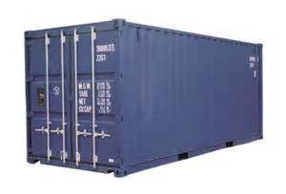

Slide 14
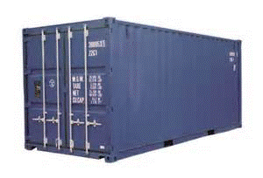
VMs vs Containers
Containers are isolated,
but share OS kernel and bins/libraries
App
A
App
A’
App
B
Bins/
Libs
Bins/
Libs
Bins/
Libs
Better Portability, Agility and Cost
VM
Guest
OS
Guest
OS
Guest
OS
Guest
OS
Guest
OS
App A
App B’
App B’
App A’
Container
App B
App B’
Bins/Libs
Bins/Libs
Hypervisor (Type 2)
Docker Engine
Host OS
Host OS
Server
Server
Picture Source: www.docker.com
Notes:
Why Docker?
Instead of maintaining configuration files, developers can create an image of their system and share it directly with their team
Any changes to local environments produce a new image that can be re-shared.
When capturing a new Docker container, the tooling only needs to capture the differences between the original and the new container. This makes it possible to rationalize Docker as a kind of version control system for disk images.

Slide 15
#2: Docker’s ecosystem is a secret sauce.

Slide 16
Terminology
Docker Host Containerization virtualization service
Docker Hub Sharing and managing images
Docker Containers Actual running of applications
Docker Client Communication between user and Docker Host
Docker Image ready-only templates that help launch Docker containers
DockerFile Instructions to automate image creation

Slide 17


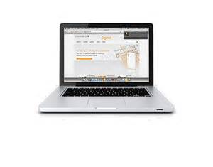
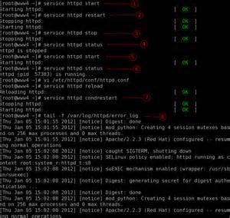


Docker Ecosystem
Docker Hub
Docker Host
Docker Client
Pull
Push
Container A
Create
Delete
List
Container B
Private Repositories
…
Private Repositories
Source Code Repo
Notes:
Docker is an open source engine that automates the deployment of any application as a portable, self-sufficient container
that can run almost anywhere.
Client can be Windows, Mac, ..
Host machine can be in Azure, DC, …
Docker containers simplify the development of software applications that consist of micro-services. Each service then operates as an isolated execution unit on the host. Common use cases for Docker include:
Automating the packaging and deployment of applications
Creation of lightweight, private PaaS environments
Automated testing and continuous integration/deployment
Deploying and scaling web apps, databases and backend services
Docker’s container technology aims to drive developer productivity and agility. Containers do not include a full operating system, consequently rapid development and scaling of container-based applications is possible through very quick boot and restart operations. Furthermore, highly efficient creation of modified container images, by virtue of only capturing the differences between the original and new containers, enables improved management and distribution of containerized applications; the resulting images are both small and highly portable across almost any platform.
A partnership between Docker Inc. and Microsoft will enable the Docker client to manage multi-container applications using both Linux and Windows containers, regardless of the hosting environment or cloud provider. This level of interoperability is what we at MS Open Tech strive to deliver through contributions to open source projects such as Docker.

Slide 18
#3: Azure makes deploying Docker easy.

Slide 19
Demos
Deploying a Docker Host from Azure Marketplace
Creating a Docker VM using the Azure Xplat-CLI
Fast container scaling & Monitoring

Slide 20
#4: Docker is a first-class citizen in Azure tooling.

Slide 21
Tools
Out of box CLI experience
“One click” Azure portal experience
Use same DevOps tools
Configuration Management
Monitoring

Slide 22
#5: Azure passes Docker’s benefits along to our customers.

Slide 23

Performance: Image Mirroring
Docker Proposal

Slide 24
Networking
Network driver implementation for Azure
Containers on a specific network can communicate freely.
Segment traffic through multiple networks
Container endpoints to join a container to multiple networks
Default endpoint is added to a sandbox to provide it with network connectivity.
Docker Proposal - 9983

Slide 25
#6: Docker Hub is coming to Azure.

Slide 26

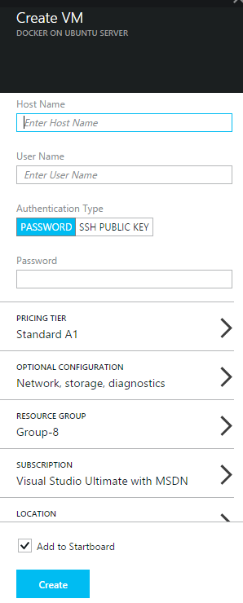
Docker Hub / Azure Marketplace Integration
M 0
M I
M II
M III
M IV
Future..
Docker Engine on Ubuntu 14.04 LTS
Docker Engine on multiple Linux Distros
Publish DockerHub Top curated images to Marketplace
DockerHub
Top curated images on Marketplace UI
All popular images visible on Marketplace
Orchestration Integration, Container as a Resource Provider, Windows Containers…….

Slide 27
#7: Orchestration: Bringing distributed apps into the real world.

Slide 28
Docker Orchestration APIs
Support for OSS container orchestration and composition systems: Mesos, Deis, Tutum and Flynn..
Participating in design and contributions (OSS)
Orchestration APIs
Networking,
Host cluster deployment,
Groups of containers,
Service discovery and definition

Slide 29
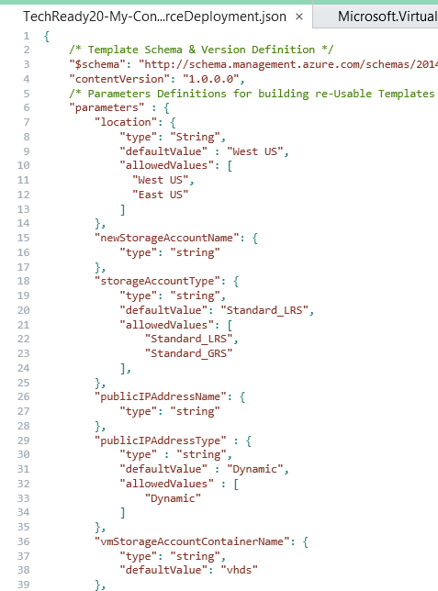
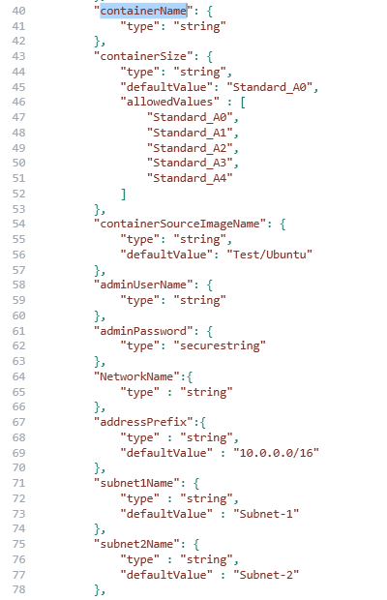
Azure Resource Model Templates

Slide 30
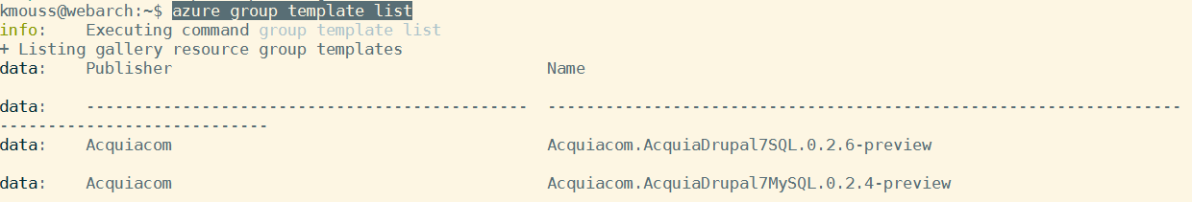
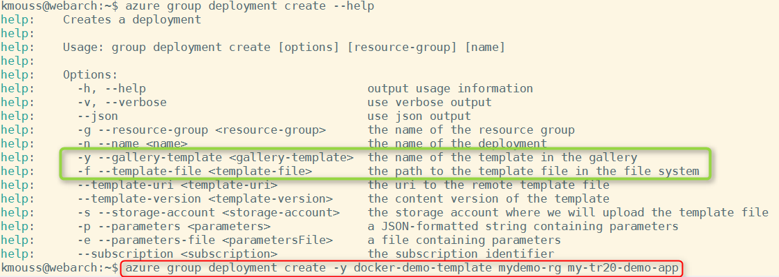
Deploying Azure container resources

Slide 31
#8: Docker’s Open Orchestration APIs. We’re here to help.

Slide 32
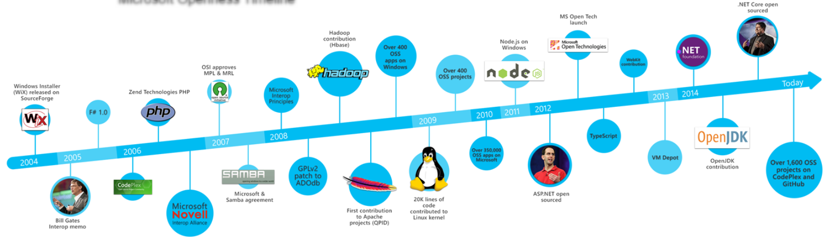

Picture Source: http://opensource.microsoft.com/
“MS Open Tech has been a wholly owned subsidiary for Microsoft for the past few years, helping customers build bridges between Microsoft and non-Microsoft technologies and powering interoperability through open standards and open source. The team has engaged on a diverse array of OSS work from engineering, standards, and technical evangelism resulting in strong contributions to open source building blocks for interoperable cloud services and have played a critical role in enabling developer choice of programming languages on Microsoft Azure, including Node.js, PHP, Python, and Java in addition to .NET.”

Slide 33
OSS Contributions
Pull Requests (PRs)
Start design contribution on the mailing list
Issues submitted through public GitHub repo
Check existing issues first ☺
Merge Approval
Sign off on work as open source

Slide 34
#9: Azure + Docker shows off the new Microsoft.

Slide 35
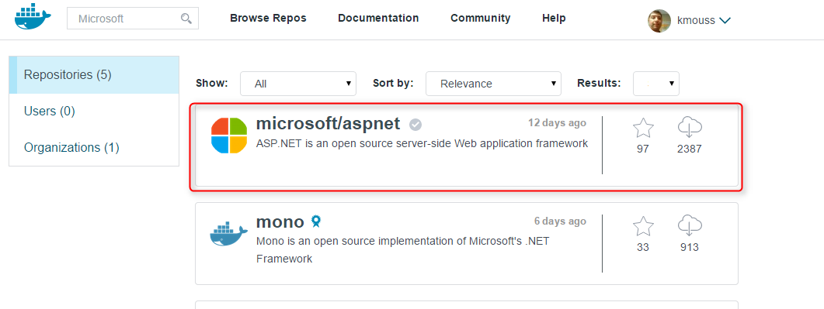
Azure + Docker

Slide 36
#10: Docker is coming to Windows.

Slide 37
Windows Containers
Planned for next Windows version
CDP213: Integrating Docker and Microsoft: Benefits of container technologies

Slide 38
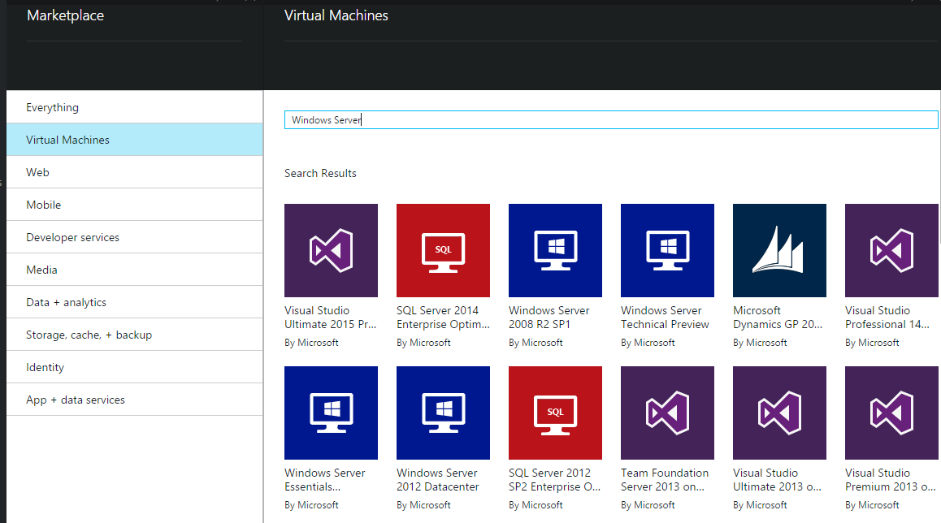



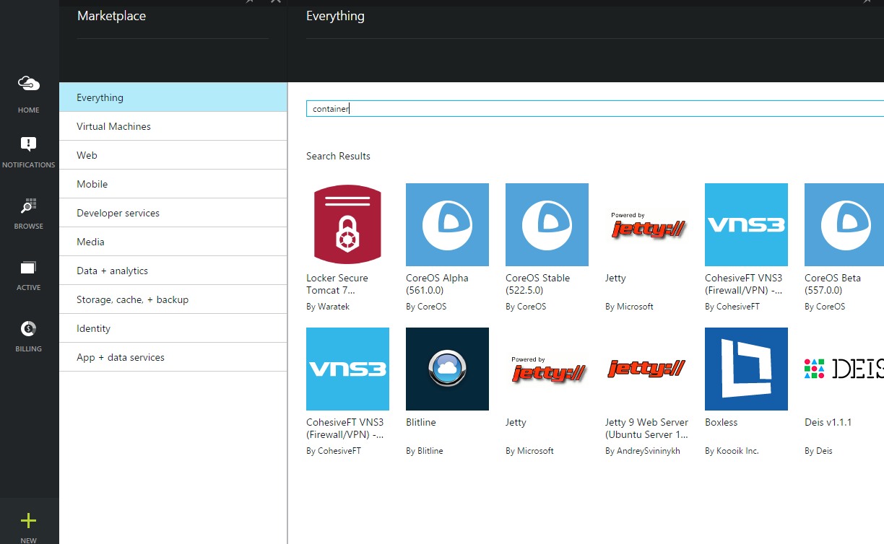
Windows Containers on Azure
Windows Server Image
Windows Extension
Curated Extensions
Agent
Azure
Notes:
Auto-Update
Avoids security implications of “reaching out”
Allows trusted and maintained partner packages
Enables partners to support ALL platform images
Creates partner and customer consistency, on-prem and in the cloud.

Slide 39
Related Content
Breakout Sessions/Chalk Talks
AZR321: Linux on Azure – Options we have, Best practices and case studies Madhan Arumugam, Guy Bowman 10:30 AM 1/30/2015 (PST)
AZR323: Container Technologies on Azure: From Beginners to Experts Haishi Bai 10:30 AM 1/30/2015 (PST)
AZR322: DevOps in Azure using Chef, Puppet, DSC, Docker and others Kundana Palagiri, Varun Maker 2:45 PM 1/30/2015 (PST)
CDP213: Integrating Docker and Microsoft: Benefits of container technologies Hari Pulapaka, Taylor Brown 1:00 PM 1/26/2015 (PST)
Notes:
Speakers should use this slide to identify content, related to their presentation, being offered in other sessions or labs at TechReady.
Your Track PM can provide a full listing of all of the sessions, hands-on labs, Instructor-led Labs and TechReady Talks in your track, as well as the other tracks.
If there is additional content available that attendees should know about, please add a section for Additional Resources to the slide. In this section you can call out whitepapers or websites that you and your team have created.
If you have questions, please contact your Track PM. See slide 5 in this template for a complete list of Tracks and TPMs.

Slide 40
Please Complete An Evaluation Form Your input is important!
Multiple ways to access Online Evaluation Forms:
CommNet stations located throughout conference venues
Via both TechReady Windows Phone and Windows 8.1 Event Apps
Via traditional TechReady Schedule Builder Windows Phone 7/8 Application
Via BYOD browser from any wired or wireless internet connection to https://www.MyTechReady.com
For more information, please refer to CommNet
Speaker – Click Here to Launch Video
Notes:
Speakers: The Launch Video button is not activated at this time. Please note this slide will be exchanged for the actual evaluation slide onsite when it will be linked to videos designed to encourage attendees to complete their evals. During your session, the evaluation video needs to be activated by you clicking on the launch video button on this slide.

Slide 41

© 2015 Microsoft Corporation. All rights reserved. Microsoft, Windows, and other product names are or may be registered trademarks and/or trademarks in the U.S. and/or other countries.
The information herein is for informational purposes only and represents the current view of Microsoft Corporation as of the date of this presentation. Because Microsoft must respond to changing market conditions, it should not be interpreted to be a commitment on the part of Microsoft, and Microsoft cannot guarantee the accuracy of any information provided after the date of this presentation. MICROSOFT MAKES NO WARRANTIES, EXPRESS, IMPLIED OR STATUTORY, AS TO THE INFORMATION IN THIS PRESENTATION.

Slide 42

The new Microsoft visual identity system capitalizes on our product experiences.
It helps us be simple, clear, and direct. It elevates the content that matters most. It creates delightful connections.
The visual elements—logo, typography, tiles, color, and imagery—make it easier to create memorable internal and external communications.

Slide 43
Pie chart 1

Slide 44
Pie chart 2

Slide 45
Horizontal bar chart
Label 1
Label 2
Label 3
Label 4
Label 5

Slide 46
Line chart
Label 1
Label 2
Label 3

Slide 47
Chart example

Slide 48
2 column table Tables are easy to modify
Text | Text
Text | Text
Text | Text
Text | Tip: To quickly add a row, place cursor in this last cell and hit Tab key

Slide 49
3 column table Tables are easy to modify
Table header | Table header | Table header
Text | Text | Text
Text | Text | Tip: To quickly add a row, place cursor in this last cell and hit Tab key

Slide 50
4 column table Tables are easy to modify
Table header | Table header | Table header | Table Header
Text | Text | Text | Text
Text | Text | Text | Tip: To quickly add a row, place cursor in this last cell and hit Tab key

Slide 51
More tables…
 | Header 1 | Header 2 | Header 3
Row 1 | Text | Text | Text
Row 2 | Text | Text | Text
Row 3 | Text | Text | Text
Row 4 | Text | Text | Tip: Place cursor in last cell and hit Tab key to add a row

Slide 52
More tables…
 | Header 1 | Header 2 | Header 3 | Header 4
Row 1
Row 2
Row 3
Row 4

Slide 53
Color map
 | FY13 | FY14 | Overall
US
Canada
LATAM
UK
Germany
France
WE
CEE
MEA
Japan
APAC
GCR
India

Slide 54

Our logo
Our logo lets people know who we are. It’s our calling card.
That’s why we use the full-color Microsoft logo on every communication, whether we’re talking about a particular product, a company-wide offering, or anything in between. By starting with the Microsoft logo, we align all of our efforts to create a more cohesive Microsoft story.

Slide 55







Microsoft logo
Restricted uses
There are circumstances that the logotype, symbol, and one-color logo may be used. These uses must be approved by Microsoft Brand Studio.
Clear space and minimum size
Clear space
We respect the logo by giving it some space. The preferred clear space is equivalent to the height of the symbol. The minimum clear space that must surround the logo is equivalent to the height of its capital M.
Use the full-color log on every communication
The logo has two components: the symbol with the multiple squares of color, which symbolize the company’s diverse portfolio of products, and the logotype in the Segoe typeface, which is used in our products and marketing communications.
Logotype
The Microsoft logotype should not be used by itself, separate from the symbol, other than in circumstances approved by Microsoft Brand Studio.
Preferred clear space
The stand-alone symbol
The symbol may not be used by itself except in a few specific circumstances approved by Microsoft Brand Studio.
Minimum clear space
One-color logo
Use of the one-color logo is restricted to instances where printing limitations dictate. If required, the preferred option is an all-white logo reversed out of a color. On unprinted finishes, etching or embossing is allowed. All all-black logo can be used for newsprint.
Minimum size
In print, the logo should never appear smaller than 1” (25mm). One-screen, it must appear at least 70 pixels wide.

Slide 56

Logo background colors
The full-color logo may be shown on any of the colors shown here or on simple areas of photographs.
Don’t place the logo on backgrounds that provide insufficient contrast.
White
Mid Gray
Dark Gray
Rich Black
Magenta
Dark Magenta
Purple
Dark Purple
Dark Red
Blue
Mid Blue
Dark Blue
Teal
Dark Teal
Green
Dark Green

Slide 57



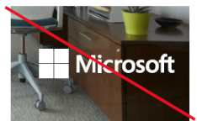

Placing the logo on a photograph
The full-color logo needs to appear on simple areas of photographs.
Don’t place the logo over busy backgrounds.
Don’t use the logo that is reversed to white in a full-color communication.

Slide 58





Microsoft logo placement For Microsoft-branded communications
When placing the Microsoft logo in a corner, it should be aligned to the interior margins (magenta grid lines).
Place Microsoft logo in any of the four corners: Upper left corner
Lower right corner
Lower left corner
Don’t place the Microsoft logo in a cornerstone tile.
Upper right corner

Slide 59
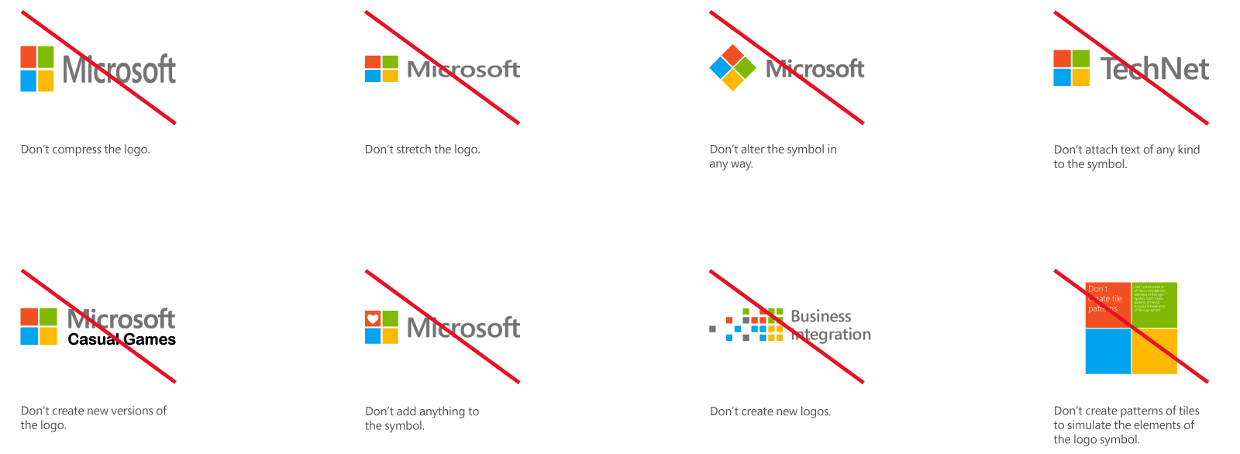

Slide 60
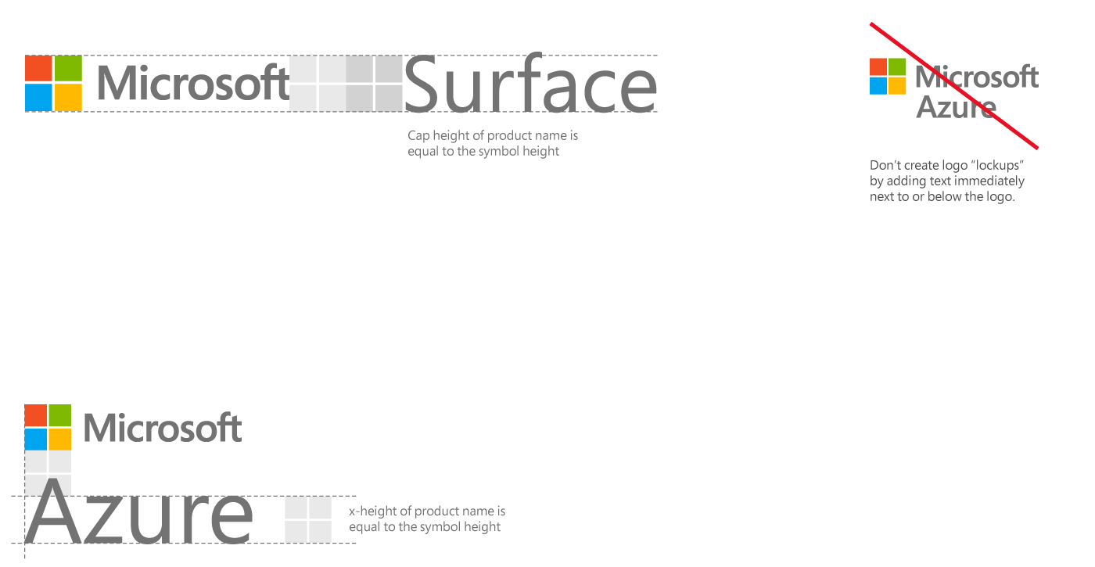
Microsoft-led products and services
Proximity, order and size
There are some simple guidelines to apply when you’re placing a product or service name on the same layout with the Microsoft logo.
The product name should always be placed to the right of, or below, the logo. We remove the word Microsoft from the product name so the logo works with it to create a complete name.
Horizontal
The lowercase letters in the product name can be no closer than one symbol-height below the Microsoft logo. The left edge of the product name aligns to the left edge of the symbol.
Vertical
The product name can be no closer than two symbol-widths to the right of the Microsoft logo. The baseline of the product name aligns to the baseline of the symbol.

Slide 61
Segoe is our type family
A modern, easy to read, and humanist typeface, the Segoe font family is closely aligned with the help of Microsoft brand personality. Use Segoe to help deliver our messages in a clean, simple, and direct way. It makes our communications feel like they come from Microsoft.

Slide 62
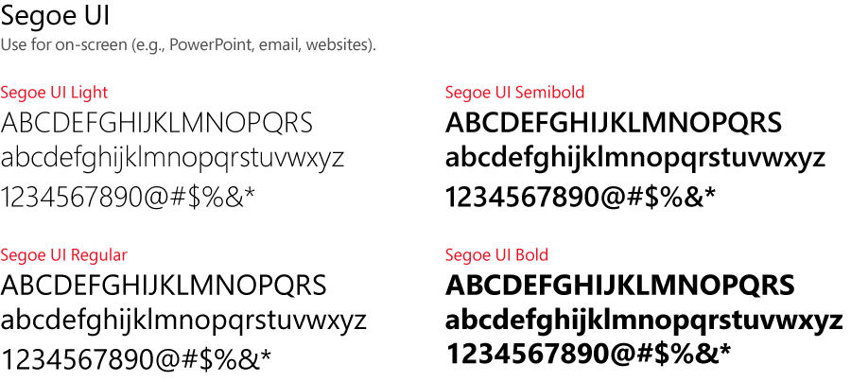
Segoe UI is the font that’s used for on-screen and digital executions
Follow these guidelines for PowerPoint
Size and weight
Limit type to no more than three sizes on a slide
Use Light for text larger than 28pt
Use Regular or Semibold for increased legibility at small sizes or over backgrounds
Use Semibold or Bold for subheads, but not for headlines
Segoe Black and Condensed should be used sparingly
Case
Sentence case is our standard for all communications
Use all-uppercase sparingly – for titles, short headings, or subheadings, and never for full paragraphs
Don’t use all-lowercase type
Justification
Type should be set flush left, ragged right
Avoid windows, orphans and lines that end with hyphens

Slide 63
Presentation fonts/typography
Segoe UI is used for PowerPoint
Any font size 28pt or larger should use Segoe UI Light
On one slide, try to use a maximum of 3 font sizes
Control focus by using scale versus bullets
Use color to draw focus when necessary
Start with main topic at 40pt and subtopics at 20pt
Title/sentence casing and periods
Title text should be “sentence case”
All supporting slide text should be sentence case except for names and products
In PowerPoint, periods are used sparingly. They are only when needed to separate lines of text.

Slide 64
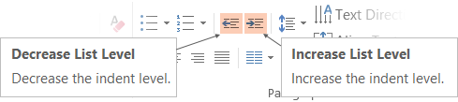
Adjusting list levels
Main topic 1: size 40pt
Size 20pt for the subtopics
Size 20pt for the subtopics
Main topic 2: size 40pt
Size 20pt for the subtopics
Size 20pt for the subtopics
Main topic 3: size 40pt
Size 20pt for the subtopics
Size 20pt for the subtopics
Use the “Decrease List Level” and “Increase List Level” tools on the Home Menu to change text levels.
Try this:
Place your cursor in any row of text to the left that says “Size 20pt for subtopics”
Next click the Home tab, and then on the “Decrease List level” tool. Notice how the line moves up one level.
Now try placing your cursor in one of the “Main topic…” lines of text. Click the “Increase List Level” tool and see how the text is pushed in one level
Use these 2 tools to adjust your text levels as you work

Slide 65
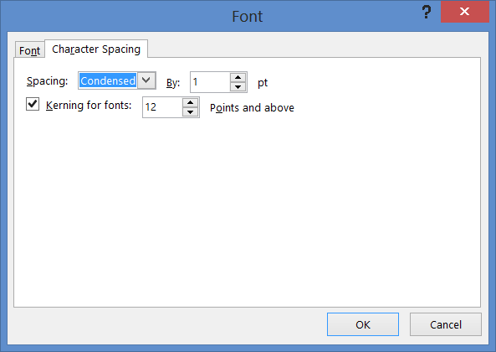
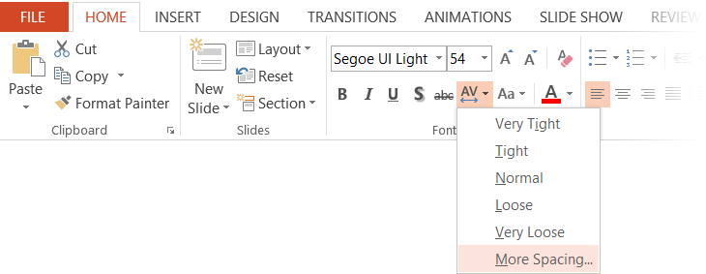
Character spacing
Type that is size 54pt and larger should be condensed by 1pt
Type that is smaller than 54pt should be normal

Slide 66
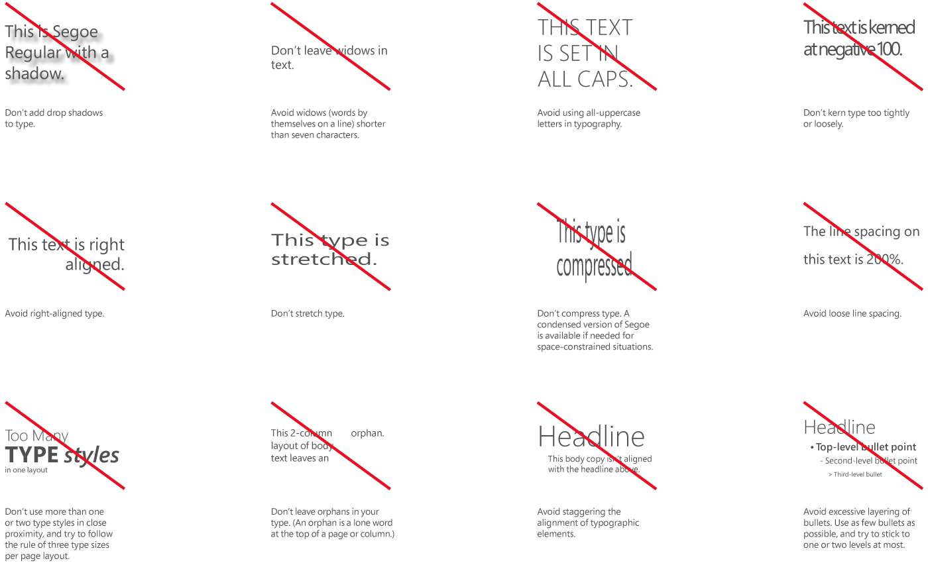

Slide 67
Grids bring structure to simplicity
The underlying structure of all Microsoft design, grids help balance your layout, creating the spacing and information organization that will guide customers to the most important visual elements and messages.

Slide 68
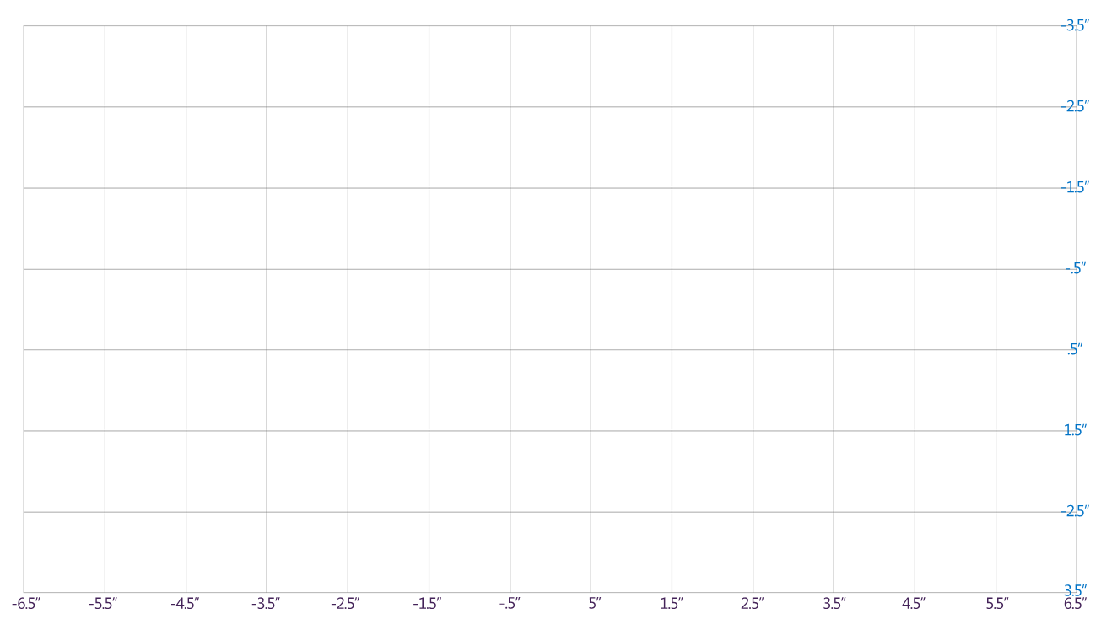
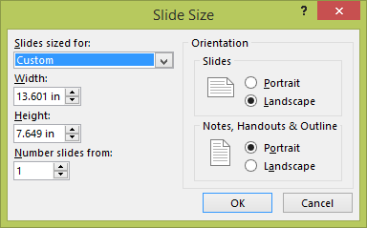
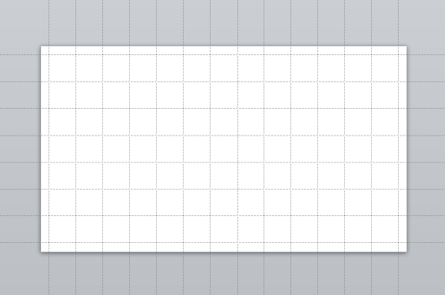
The recommended 16:9 grid
Tip: Turn off PowerPoint’s drawing guides when viewing this slide in normal view. (View menu > uncheck the box in front of Guides)
For 16:9 aspect ratio PowerPoint templates
The recommended grid for 16:9 PowerPoint templates is shown on the left. The grid is provided in .png format on the next slide
When building slides, it’s easier to use PowerPoint's drawing guides, as shown below. Content tiles can be easily snapped and aligned to drawing guides.
The PowerPoint drawing guides in this template have been positioned (as shown below), using the numeric settings shown on the left.
IMPORTANT: 16:9 slide dimensions must be set to: 13.6”w x 7.65”h (Design menu > Slide size > Custom slide size. PowerPoint will reset to the size to 13.601”w x 7.649”h – this is okay.)
13 columns
1” x 1” grid units
7 rows

Slide 69

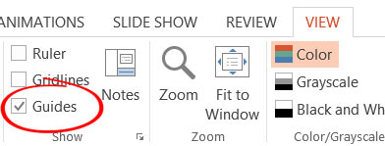
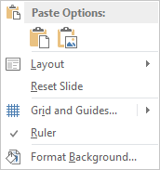
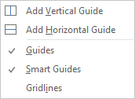
The .png grid
-3.5”
This grid on this slide is a graphic in .png format. It can be copied and pasted onto other slides, but ALWAYS remove it before finalizing the slide.
-2.5”
TRY THIS: Turn on PowerPoint drawing guides. Click on the View menu along the top, and then check the box to the left of Guides.
Notice how the guides align to this .png guide, so you don’t even need to use this graphic.
Add additional guides as you need. To add a guide, right-click on the gray area outside the slide area. From the pop-up menu, choose Grid and Guides… and then choose Add Vertical Guide or Add Horizontal Guide. A gray guide will be added in the center of the slide. Click to drag it where you want it to be positioned. To remove it, drag it off the edge of the slide.
-1.5”
-.5”
.5”
1.5”
-2.5”
3.5”
-6.5”
-5.5”
-4.5”
-3.5”
-2.5”
-1.5”
-.5”
-5”
1.5”
2.5”
3.5”
4.5”
5.5”
6.5”

Slide 70
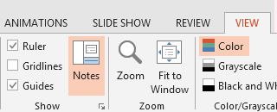
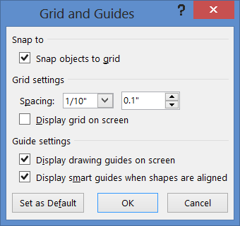
Grid and guide tips
-3.5”
-2.5”
POWER USER TIPS: Set your grid and guides as shown in the lower left picture. Then as you work, use the arrow keys to quickly nudge and align shapes to the grid.
To temporarily release the snap behavior use these shortcuts:
When nudging shapes, hold down the Ctrl key.
When resizing shapes, hold down the Alt key.
To turn off snap behavior, uncheck all boxes.
If you find the drawing guides distracting, use the View menu > Guides checkbox to quickly hide and unhide the drawing guides as you work.
The fine print. You can set the same drawing guide settings in existing 16:9 aspect ratio PowerPoint templates.
First, change the PowerPoint page dimensions to: 13.6”w x 7.65”h. (Design menu>Page Setup).
Next, on the View menu, click the tiny arrow in the bottom right corner of the Show submenu. Check the box in front of Snap objects to grid, and set the grid spacing to .1” Click OK.
Reposition the drawing guides so they align to the numeric values shown on this slide. To remove a drawing guide, click and drag it off the slide. To add a drawing guide, click on any existing guide while holding down the Control key and dragging the guide. A duplicate guide will be created.
Interior margins will also need to be set so text aligns correctly. Refer to the “Interior Margins” slide later in the deck.
-1.5”
-.5”
.5”
1.5”
-2.5”
3.5”
-6.5”
-5.5”
-4.5”
-3.5”
-2.5”
-1.5”
-.5”
-5”
1.5”
2.5”
3.5”
4.5”
5.5”
6.5”

Slide 71
We are colorful
Life happens in color. Color captures passions, inspires emotions, and connects us. Bright and energetic, our colors add vibrancy. They are among our most recognizable elements. Color helps to unify our visual identity.

Slide 72
Our brand colors
Layouts should use our eight brand colors as the primary palette in communications.
Digital and on-screen applications use RGB or HEX color formulas. The color formulas are shown below.
Yellow
R255 G185 B0
FFB900
Orange
R216 G59 B1
D83B01
Red
R232 G17 B35
E81123
Magenta
R180 G0 B158
B4009E
Purple
R92 G45 B145
5C2D91
Blue
R0 G120 B215
0078D7
Teal
R0 G130 B114
008272
Green
R16 G124 B16
107C10

Slide 73
Accessibility
Type and background combinations must meet a minimum 4.5:1 contrast ratio or greater for accessibility. Examples below demonstrate correct color use for on-screen applications. Colors shown with notched corners require black/dark text to be accessible.
Light Yellow
R255 G241 B0
FFF100
Light Orange
R255 G140 B0
FF8C00
Light Magenta
R227 G0 B140
E3008C
Light Purple
R180 G160 B255
B4A0FF
Light Blue
R0 G188 B242
00BCF2
Light Teal
R0 G178 B148
00B294
Light Green
R186 G216 B10
BAD80A
Light accent colors
Yellow
R255 G185 B0
FFB900
Orange
R216 G59 B1
D83B01
Red
R232 G17 B35
E81123
Magenta
R180 G0 B158
B4009E
Purple
R92 G45 B145
5C2D91
Blue
R0 G120 B215
0078D7
Teal
R0 G130 B114
008272
Green
R16 G124 B16
107C10
Microsoft 8 brand colors
Dark Red
R168 G0 B0
A80000
Dark Magenta
R92 G0 B92
5C005C
Dark Purple
R50 G20 B90
32145A
Dark Blue
R0 G32 B80
002050
Dark Teal
R0 G75 B80
004B50
Dark Green
R0 G75 B28
004B1C
Dark accent colors (+ one mid accent color)
Mid Blue
R0 G24 B143
00188F
For more information on accessibility, visit: Microsoft.com/enable.
White
R255 G255 B255
FFFFFF
Light Gray
R210 G210 B210
D2D2D2
Mid Gray
R115 G115 B115
737373
Dark Gray
R80 G80 B80
505050
Rich Black
R0 G0 B0
000000
White, black and gray accent colors

Slide 74
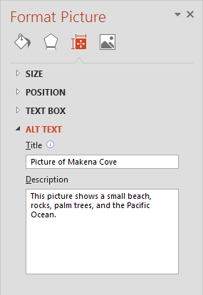
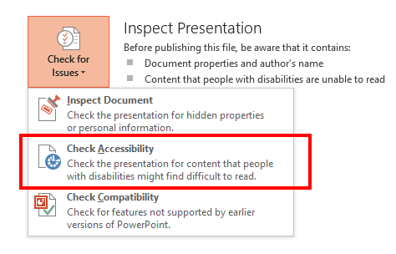
Creating accessible content
Accessibility definition
Developing an equal experience for all users that enables individuals to adjust their user experience to meet their unique visual, hearing, dexterity, cognitive, and speech needs.
4 simple ways to improve accessibility in your presentations:
Use high contrast colors for maximum readability
Recommended contrast ratio is 4.5:1
Accommodate for color blindness
Use different shapes with a legend to indicate status
Add ALT TEXT for images & pictures
This assists people who use screen readers
Use the Office 2013 Accessibility Checker
File > Check for Issues > Check Accessibility
Download Contrast Analyzer Tool
Best
Here’s how:
Right click the image
Select Format Picture
Select the Size & Position icon
Expand the ALT TEXT field
Enter a Title and Description
OK
On track
Needs work
Not on track
Not accessible
More presentation accessibility tips here
Learn more at http://enable
Notes:
On

Slide 75
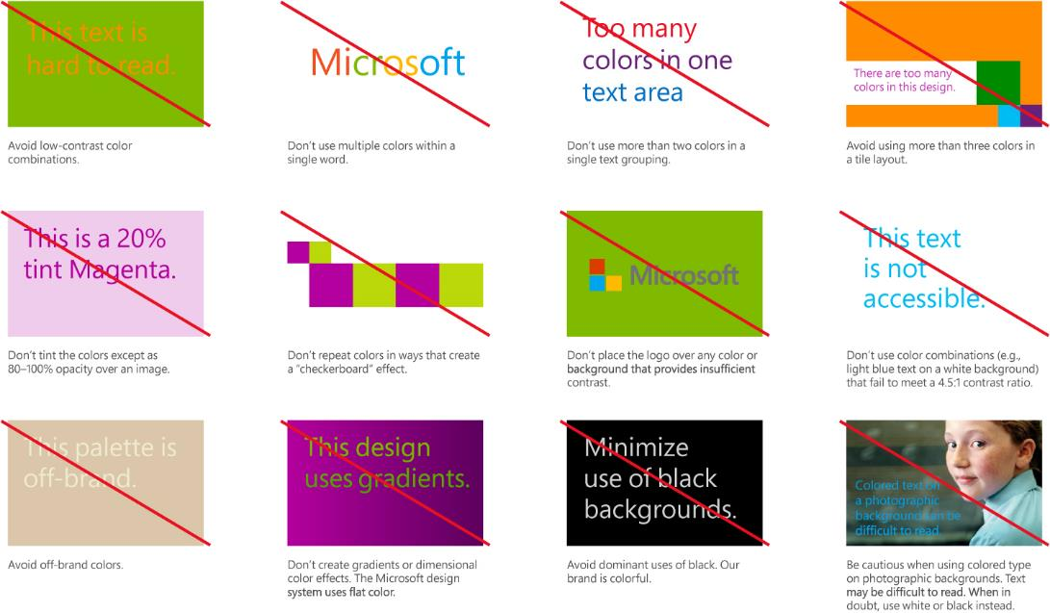

Slide 76
Illustration showcase

Slide 77
Our illustrations are engaging, active and vivid

Slide 78



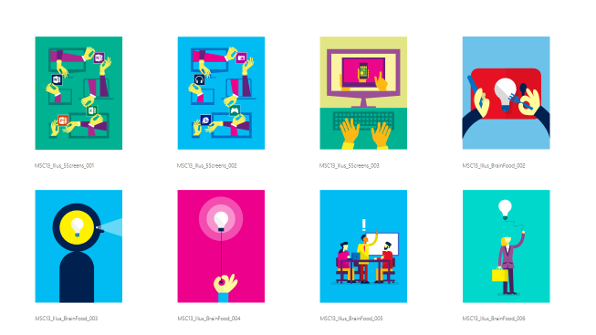
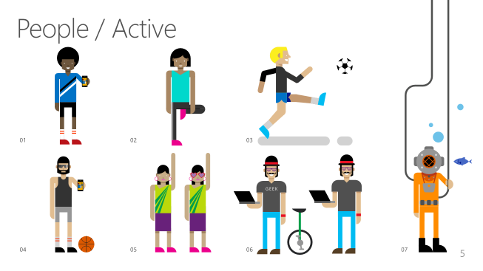
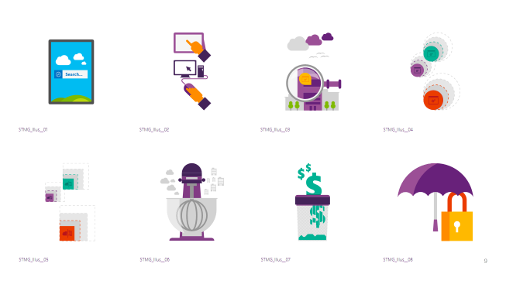
Illustration resources and guidelines
3 PowerPoint decks with illustrations:
Download from Brand Tools:
https://brandtools.microsoft.com/Microsoft/Bundle/Pages/Illustrations_Editable_AllCollections/Illustrations_Editable_AllCollections.aspx
Corporate collection
Microsoft.com collection
Cloud & Enterprise collection

Slide 79
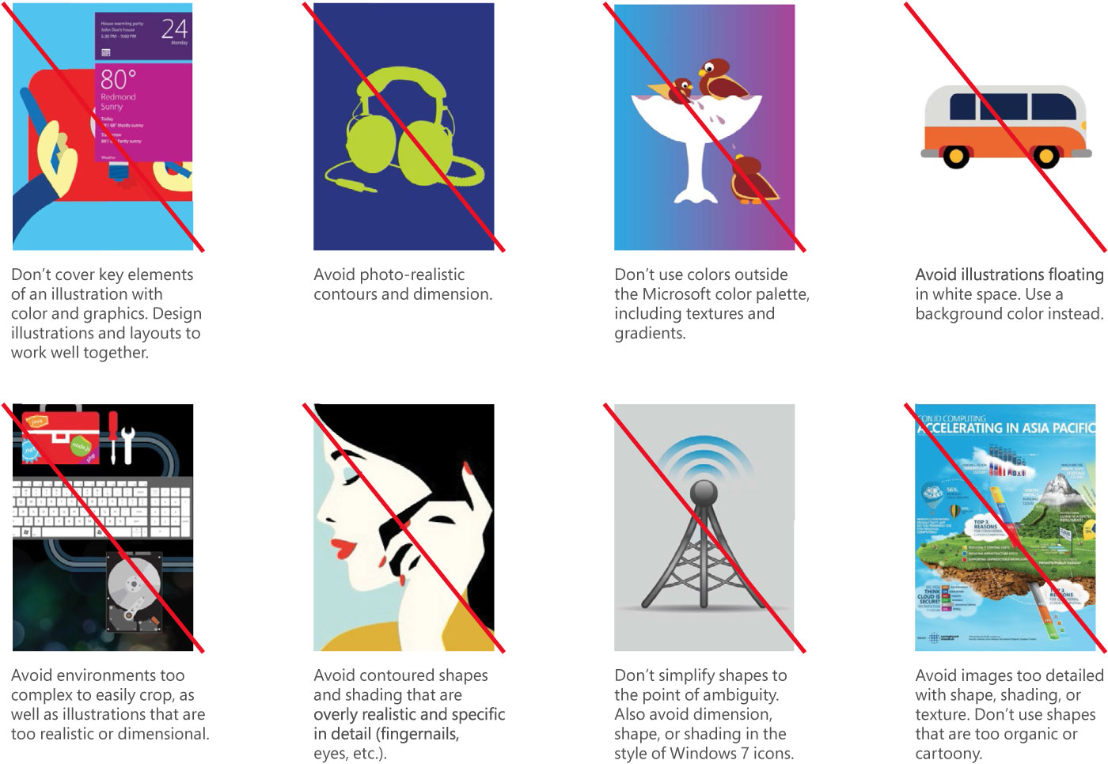
What to avoid when using or producing Microsoft illustrations:
Avoid decorative illustrations without an informational purpose
Avoid photo-realistic or 3D style
Avoid static illustrations
Avoid cartoony illustrations
Avoid textures and gradients
Avoid complex environments that make cropping difficult
Avoid floating images over white backgrounds
Avoid images that are not flat
Avoid contoured shapes, shading and texture
Avoid shapes that are too detailed or specific
Don’t be simplistic or juvenile
Avoid illustrations that are too organic

Slide 80



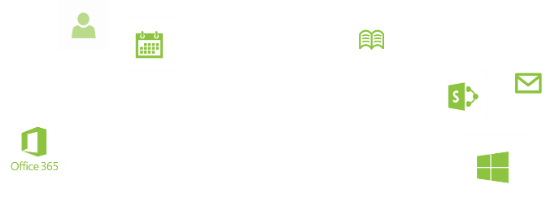
Apps for everyone

Slide 81
Sample content with illustration

Slide 82

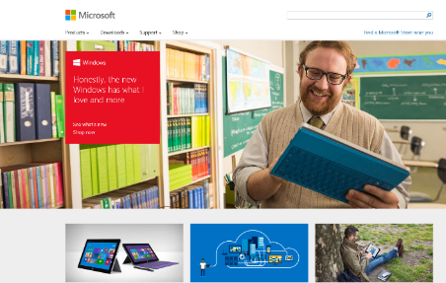
Get started http://www.microsoft.com

Slide 83
Morning break

Slide 84

Check out our new mobile app!

Slide 85



Custom illustrations
The designers at Silver Fox Productions have spent some time creating custom illustrations for speaker use.
If you are in need of a custom illustration, Silver Fox can help. Whether it is already present in their library or needs to be conceptualized and created, please email TechReady@silverfoxprod.com, they would be more than happy to help. Please see some examples below.

Slide 86

Photos and illustrations tell our story
The impact of our imagery depends upon how authentically we tell our stories. With every image, we look to tell our audience of people’s passion as they realize it through the use of our technology. We’re inspired by people’s drive for life and their enthusiasm for the future.

Slide 87

Our photos are authentic, optimistic and brave
And expansive set of shared lifestyle and product photography is available for use in Microsoft communications. Avoid purchasing stock photography whenever possible.

Slide 88

When text isn’t legible on a full-bleed photo, a content tile can be used.
It can be fully opaque or 5-20% transparent.

Slide 89
Where can I find photos?
A few great places to start…
Brand Tools: A resource for information on the Microsoft brand
https://brandtools.microsoft.com/Pages/Home.aspx
Microsoft News Center (previously Presspass): A great place for the latest and greatest
www.microsoft.com/en-us/news
Xbox Wire Media Assets library
http://news.xbox.com/media
Featured Devices: PC, tablet and phone hardware imagery and marketing materials
https://www.featureddevices.com/
Presentation Resources: Presentation guidelines and PowerPoint templates
https://brandtools.microsoft.com/Resources/Presentations/Pages/StoryBoard.aspx#story-Landing0
Respect intellectual property rights
Photography and graphics used in presentations, for both internal and external audiences, must be owned by Microsoft or licensed appropriately.
Microsoft has agreements in place with several stock providers. Contact Media Acquisitions for more information.
Media Acquisitions (mediaacq alias)
www.superstock.com/
www.gettyimages.com/creativeimages/royaltyfree
www.corbisimages.com/stock-photo/royalty-free
Avoid intellectual property theft: Do not use photos or graphics copied from the web in presentations. When in doubt, consult with LCA http://lcaweb/CTP/Copyrights/Third-Party-Content-Use/Pages/default.aspx

Slide 90

















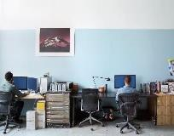
Brand photography selections, 1 of 3
Below are thumbnails of a few of the many photos that you can find on Brand Tools.
In show mode, click each image to download higher resolution copies.

Slide 91




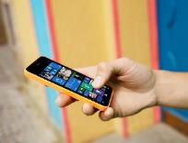













Brand photography selections, 2 of 3
Below are thumbnails of a few of the many photos that you can find on Brand Tools.
In show mode, click each image to download higher resolution copies.

Slide 92


















Brand photography selections, 3 of 3
Below are thumbnails of a few of the many photos that you can find on Brand Tools.
In show mode, click each image to download higher resolution copies.

Slide 93
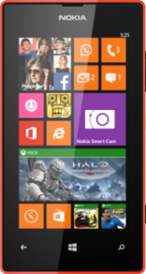
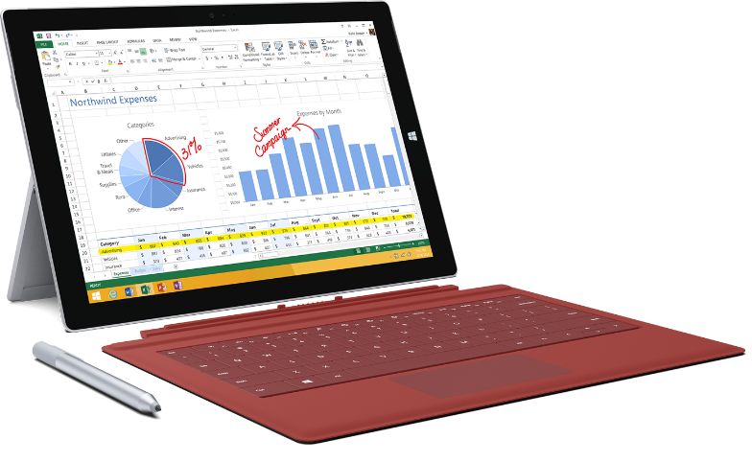
Device photography
Where to find
Microsoft device photos can be found on Brand Tools
https://brandtools.microsoft.com/Pages/Home.aspx
OEM & MS hardware (PC, tablet and phone) can be found on Featured Devices
https://www.featureddevices.com/
Hardware guidelines
Use the latest devices from the current year
Screen captures should be up-to-date
Remove OEM logos when possible
Drop shadows for devices only
Use drop shadows to provide subtle depth
Added drop shadows should appear as natural as possible

Slide 94

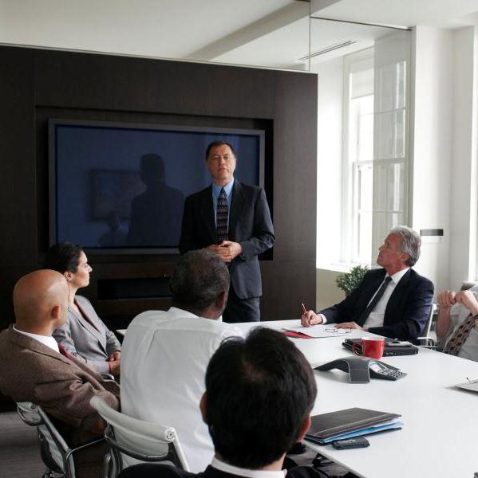
Photos and a tile
Photos and tiles can be combined. Edges should touch.
Align text to upper left corner
Content tiles (which must always have text) work well between photos
Use soft gradients behind text when needed to increase legibility

Slide 95


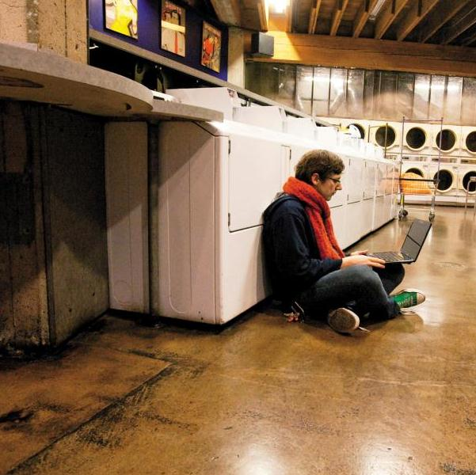
Photos separated by gaps
Design Tip: Turn on the drawing guides (View -> Guides) to see how content tiles are aligned to the underlying grid system.
It’s permissible to add 05” gaps between photos when doing so helps the photos read better.
This photo measures 3.95”w x 4”h
This photo measures 3.95”w x 4”h
This photo measures 4”w x 4”h
This text shape has no fill. It uses the same default interior margins as content tiles
Align all text blocks to the content tiles interior margins
Text can be used on, above or below photos.

Slide 96
All about icons
Simple and direct, an icon condenses a message into its simplest form. Less is more. Icons make it easier for consumers to recognize identical functions, or call to actions, in different contexts.

Slide 97
Choosing the right icons
Guidelines for icons
Icons are actionable and purposeful—they have a clear function
Resist see and say
Choose from existing brand icons
Icons should never be used decoratively
Don’t use an icon if the message can be communicated in another way
Don’t represent a complex message with an icon
Icons should only appear in white or black
They may be placed within content tiles or on backgrounds
If you need new icons…
Contact brand@microsoft.com for additional information
Do not create a new icon if one already exists

Slide 98
Icons (can be recolored in PowerPoint)

Slide 99
Icons (can be recolored in PowerPoint)
PC, Desktop
All-in-one
Laptop
Surface
Pro 3
Surface
Windows phone
Tablet
Tablet
Servers
Xbox Kinect
Xbox Controller
iPad tablet
iPhone
Bing
IE
Dynamics
MSN
Office
OneDrive
Skype
Skype
Visual Studio
Windows
Xbox
Yammer
Yammer

Slide 100
Step-by-step content tiles
Tiles establish a consistent visual language across all Microsoft brand communications. Tiles form natural structures for placing type, especially on photographic backgrounds.
As useful and memorable as tiles can be, overusing them can dilute their impact and crowd your layout. Remember to employ a fierce reduction of elements and apply tiles thoughtfully.

Slide 101
Clarity & simplicity
Not all content needs to be in tiles
Type is what articulates the message
Text doesn’t need to be bulleted
Text size can reinforce and impact
It’s more than tiles
Fierce reduction of elements
Well defined hierarchy
Scale and contrast to create interest and focus
Keen attention to detail

Slide 102
Creating content tiles
While alignment with the grid is meant to bring structure, it still remains flexible by allowing you to create tiles customized for your size requirements
Design Tip: In this tutorial section, turn on the drawing guides (View -> Guides) to see how content tiles are aligned to the underlying grid system.
Use tiles only if there is content such as text or photos and not for decoration
Always align tiles or groups of tiles with the
left margin of the layout
All type should align left along the interior margin.

Slide 103
Interior margins
All type should align to the left interior margin.
Default settings for interior margins are listed below.
These default settings for text blocks and content tiles (shapes) have been set for you:
Left: .20”
Right: .20”
Top: .16”
Bottom: .16”
Text alignment: Left
Anchor: Top
Text line spacing: Multiple .9”
All text blocks and shapes use the same interior or internal margins.
In PowerPoint, internal margins for text are set in the Format Text Effects menu and for shapes in the Format Shape menu.
These default settings make it easy to align the text in content tiles and text blocks to the same interior margin, when their outer borders are aligned to the drawing guides.

Slide 104
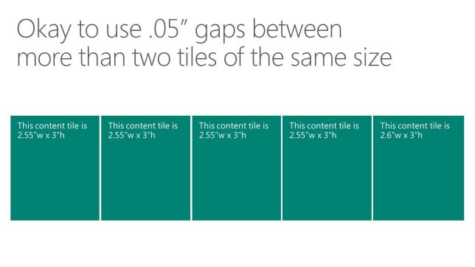
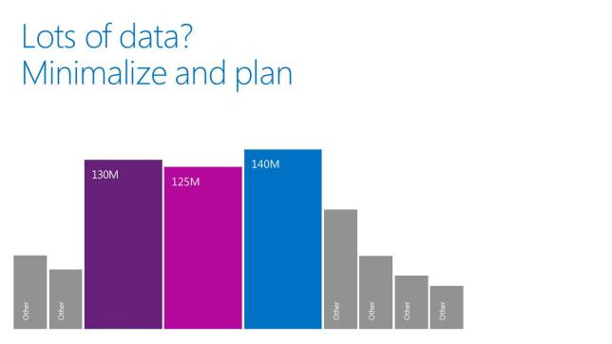
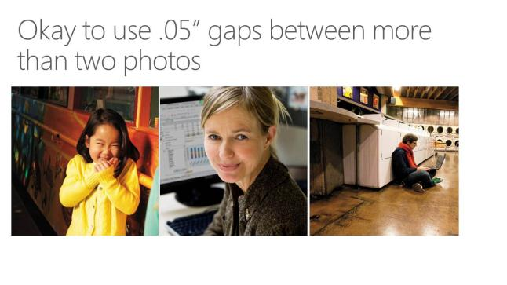
When to use gaps
Use .05” gaps between more than two tiles of the same size.
.05” gaps can be used between more than two tiles of the same size.
.05” gaps can be used in graphical layouts when it improves legibility or is necessary to separate shapes of the same color.
.05” gaps can be used between more than two photos.

Slide 105
Steps for adding gaps
Part 1
This content tile measures 3”w x 3”h
This content tile measures 3”w x 3”h
This content tile measures 3”w x 3”h
This content tile measures 3”w x 3”h
Follow these steps to quickly add space between shapes and content tiles:
Turn on the drawing guides, (On the View menu, check the box in front of Guides.)
Start with content tiles aligned to the grid as shown above (edges touching). Tiles don’t need to be square. The grid is based on 1” x 1” units, so shapes aligned to the grid be will be even inches.
Click to select the first content tile on the left, then click on the Format menu. On the far right of the Format menu, change the width to make it .05” narrower. In this example, change the width from 3” to 2.95”. Repeat the same steps for the second and third content tiles. You can select them both, to speed the process. (continued on next slide)

Slide 106
Steps for adding gaps
Part 2
This content tile measures 2.95”w x 3”h
This content tile measures 2.95”w x 3”h
This content tile measures 2.95”w x 3”h
This content tile measures 3”w x 3”h
Your slide should now look like this.
Leave the last content tile at 3”w x 3”h since no gap is needed on the right side. Although the first 3 boxes are slightly narrower, this slight size difference won’t be noticeable.
Notice how the .05” gaps opened on the right edges, and the left edges remained aligned to the grid. This is a quick way to create uniform .05” gaps.

Slide 107
Centered tiles
Limit the number of colors to no more than 3-4 on any one slide.
Slides with 5 or more tiles work well with one color.
13”
This content tile is 2.55”w x 3”h
This content tile is 2.55”w x 3”h
This content tile is 2.55”w x 3”h
This content tile is 2.55”w x 3”h
This content tile is 2.6”w x 3”h
Align all text blocks to the content tiles interior margins

Slide 108
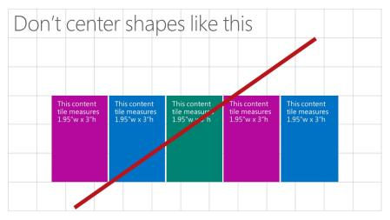
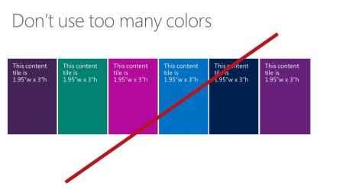
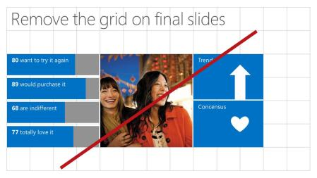






Don’t center content tiles, unless the total width equals 13”, spanning the slide from border to border.
Limit colors to no more than 3-4 on any one slide.
Don’t forget to remove the .png grid from final slides.
Keep titles aligned left.
Avoid using black content tiles. The Microsoft brand is colorful.
Don’t add tiles at 45˚ angles. They should always be added side-by-side or directly above or below the prior tile.
Don’t use tiles without text, for decorative purposes.
Don’t right-align type or objects in tiles.
Don’t middle align type. Type should be top aligned.

Slide 109
Templates and resources

Slide 110



Microsoft-branded templates For presentations where Microsoft is the lead brand
Microsoft brand PowerPoint templates are available on:
https://brandtools.microsoft.com/Resources/Presentations/Pages/StoryBoard.aspx?section=Elements1
Brand Tools Help Center – FAQs, “Ask the experts”
https://brandtools.microsoft.com/helpcenter or aka.ms/brandhelp
For slide information, email slides@microsoft.com

Slide 111



Product-branded templates Product brand as the lead, Microsoft-endorsed
Templates for core brands, such as Windows, Office etc. can be found on Brand Tools.
https://brandtools.microsoft.com – Click on “See All” > “product name” > Elements
“Starter” product brand templates designed to be customized are available on:
https://brandtools.microsoft.com/Resources/Presentations/Pages/StoryBoard.aspx?section=Elements1
Brand Tools Help Center – FAQs, “Ask the experts”
https://brandtools.microsoft.com/helpcenter or aka.ms/brandhelp
For slide information, email slides@microsoft.com

Slide 112



Org ID templates For internal org presentations to internal audiences
Org ID templates are available on: https://brandtools.microsoft.com/Resources/Presentations/Pages/StoryBoard.aspx?section=Elements1
Brand Tools Help Center – FAQs, “Ask the experts”, (use this form to request Org ID tile artwork)
https://brandtools.microsoft.com/helpcenter or aka.ms/brandhelp
For slide information, email slides@microsoft.com

Slide 113

Microsoft brand resources
Brand Tools
https://brandtools.microsoft.com
Brand Tools Help Center
https://brandtools.microsoft.com/helpcenter
or
aka.ms/brandhelp (copy this into your browser, and hit Enter)
Microsoft brand PowerPoint templates & guidelines
https://brandtools.microsoft.com/resources/presentations /pages/storyboard.aspx#story-landing0

